Slide 1
Assignment for cse 4205 - Digital Logic Design

Slide 2
Binary Ripple Counter
Follows binary sequence
Consists of a series of flip flops, with the output of each flip flop connected to the clock pulse input of the next flip flop
Flip flop of least significant bit receives main clock pulse
Uses negative edge triggers
Frequency of clock pulse input for each flip flop is half the frequency of the clock pulse input of the previous flip flop

Slide 3

Binary Ripple Counter
Signal propagates through the counter in a ripple fashion
For $n$ flip flops, the counter counts from $0$ to $2n−1$, in binary
Flip flops are not clocked simultaneously, so the counter is asynchronous
Delay of each flip flop comes into account, making the counter slow

Slide 4
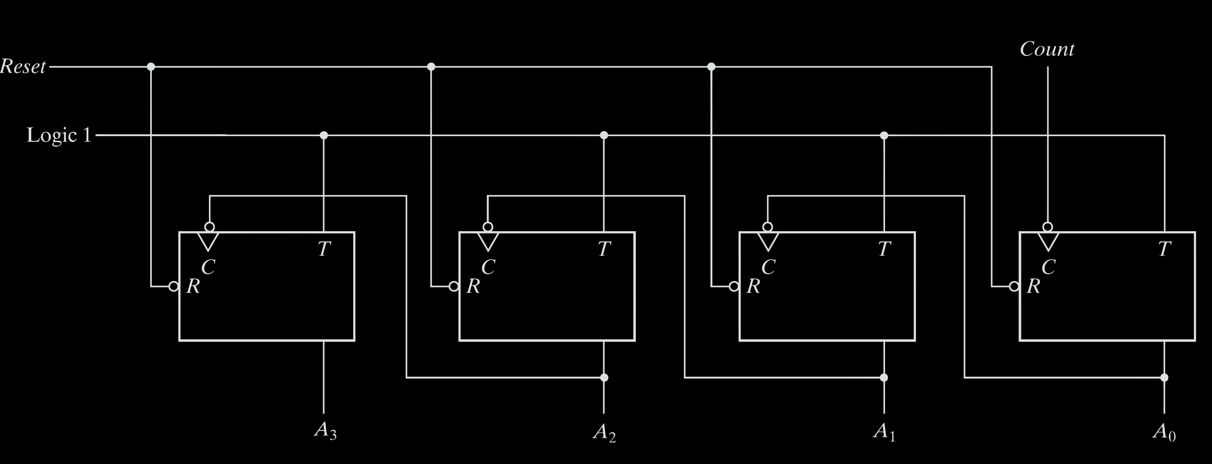
Binary Ripple Counter

Slide 5

Shift Register
Registers consist of a group of $n$ flip flops in series to store $n$ bits of data
Shift registers are capable of shifting information in one cell to its neighbor by applying clock pulses
Output of each flip flop acts as the input to the next
Data can be shifted left to right or right to left or both ways, depending on whether the register is unidirectional or bidirectional
Multiple forms of shift registers exist, like serial input serial output (SISO), serial input parallel output (SIPO), parallel input serial output (PISO) and parallel input parallel output (PIPO)
Universal shift registers combine all the different forms of shift registers

Slide 6
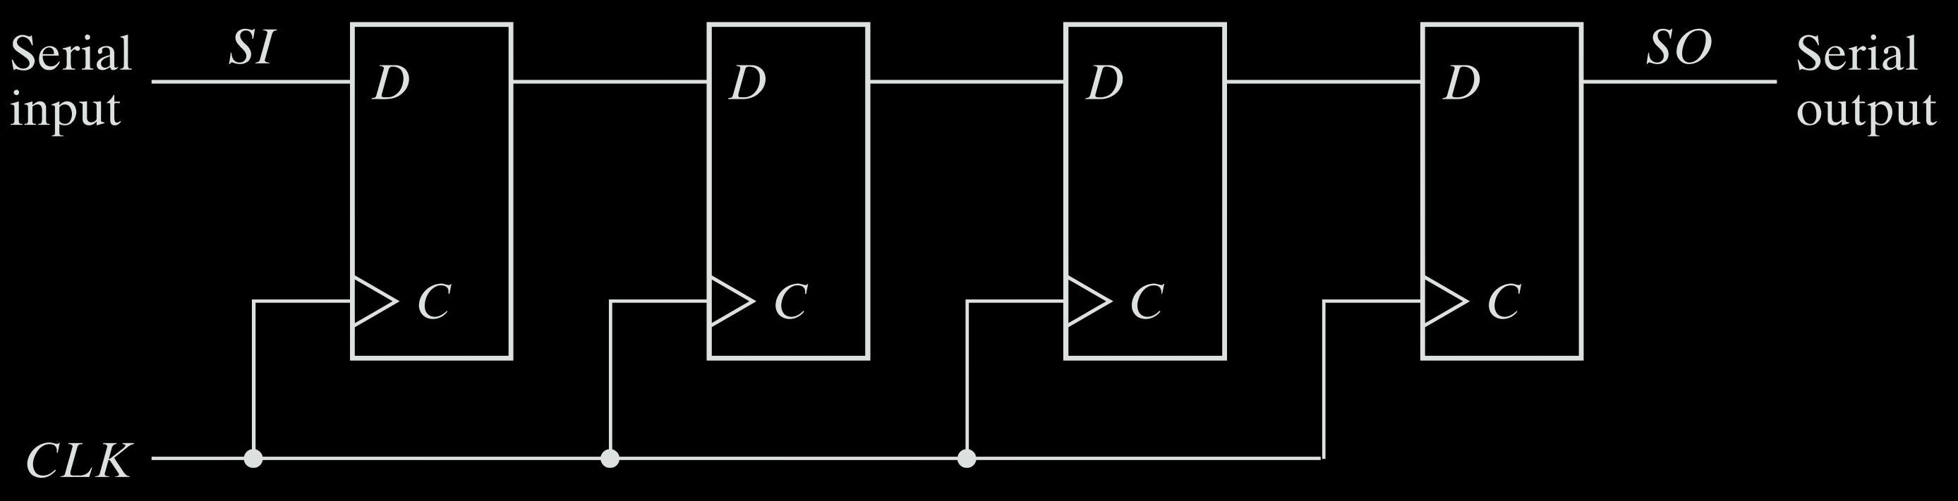
Shift Register
Left to Right Serial Input Serial Output Shift Register using D Flip Flops

Slide 7

Hamming Code
Block code capable of detecting up to two simultaneous bit errors and correcting single-bit errors
Source encodes message by inserting parity bits at the positions in the message which are powers of $2$, i.e. at $1$, $2$, $4$, $8$ etc.
The parity bits have a value of $1$ or $0$ depending on whether the number of $1$’s in the variables it considers is odd, giving the parity bit a value of $1$, or even, giving the parity bit a value of $0$
Destination receives message and performs recalculations to detect errors and find the bit position of the error

Slide 8
Hamming Code
Encoding Process
Calculation of the number of parity bits.
Positioning the parity bits.
Calculating the values of each parity bit.
Decoding Process
Calculation of the number of check bits.
Evaluating the check bits.
Error detection and correction

Slide 9
Thank you

